Slide 1
Privy Integration – Scenario I

Slide 2


Integration Scheme
Middleware
Integration
Master Customer
Posted by Privy
Active
Master Sales Order
1. Get From Privy 2. Process DW 3. Push to Netsuite
Usage Customer
Notes:
1. Contoh kasus
Unutuk sales, Ketika deals masih diinput manual.
Selanjutnya ingin integrasi langsung dengan system Privy

Slide 3
Customer Spec
Source | Spec | Type | Netsuite Mapping
Request Type | Post | Upsert
Request Param | CreateOn SortBy | Date Asc / Desc
Body | Customer ID / Reference Customer Type (Company or Individual) Company Name (If Company) Email Phone Number SalesOrderID | Uniqe ID Enum String String String String | - - -

Slide 4
Sales Order
Source | Spec | Type
Request Type | Post
Request Param | CreateOn SortBy CustomerID | Date Asc / Desc varchar
Body | Order Header Order Number / Reference Customer ID Customer Name Subtotal Tax Total Order Lines Item ID Item Name Quantity Rate Item Tax Rate Subtotal | Uniqe ID String String Money / Double Money / Double Money / Double String String Int Money / Double Money / Double Money / Double

Slide 5
Customer Usage Spesification
Source | Spec | Type | Netsuite Mapping
Request Type | Post
Request Param | CreateOn SortBy | Date Asc / Desc
Body | Customer ID Customer Name Product ID Product Name Transaction Date Usage Usage Amount | Uniqe ID String String String String Date Int Money / Double | Not Mapped custrecord_privy_customer_name custrecord_privy_id_product custrecord_privy_product_name custrecord_privy_transaction_usage custrecord_privy_quantity_usage custrecord_privy_amount Recordtype -> default value customrecordprivy_product_list

Slide 6
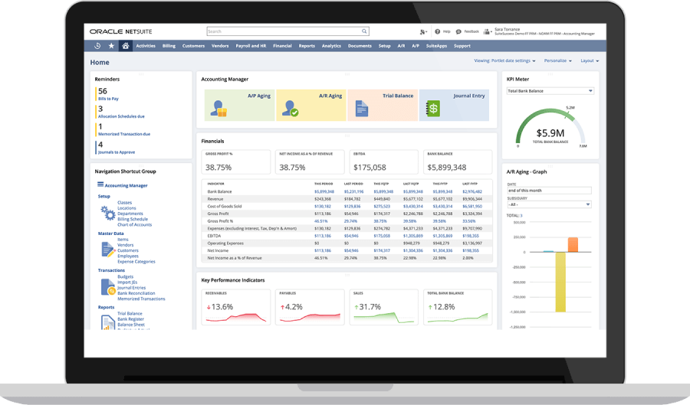







Arch Dev
Output
Batch Push
https://8113915-sb1.restlets.api.netsuite.com/
VPC
52.140.199.172
Data Processing
Size E2s v3
OS Ubuntu
vCPUs 2
RAM 4 GiB
DB : Query Processing
Data Source Sytem API
Integration
api.clickup.com/api/v2
https://api.github.com/user/repos
https://{baseulr}/services/data/v36.0/
https://api.getbase.com/v2/
Notes:
API akan disiapkan tim Apergu, untuk di mapping.
Tim Privy tidak butuh direct access ke Privy
Next Action : Preapare API untuk ke Privy

Slide 7
Arch Production
Output
https://8113915-sb1.restlets.api.netsuite.com/
VPC ?
Data Processing
Size E2s v3
OS Ubuntu
vCPUs 4
RAM 8 GiB
Webserver Ngin X
DB : Query Processing
Data Source Sytem API
Integration
api.clickup.com/api/v2
https://api.github.com/user/repos
https://{baseulr}/services/data/v36.0/
https://api.getbase.com/v2/

